Slide 1
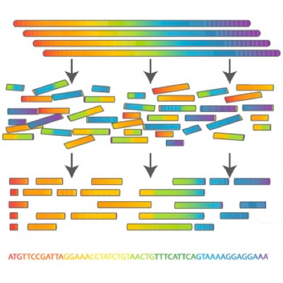

Scientific Computing for Biologists

Slide 2
Scientific Computing for Biologists
5-10 minutes for class discussion and dialog over previous lesson(s)…
Questions about previous lecture(s)?
Discussion of Final Project progress?
General Questions about scientific computing?

Slide 3
Scientific Computing for Biologists
Why learn the command line?
It’s the foundation for most of bioinformatics
Enables use of non-GUI (Graphical User Interface) tools
Can quickly perform operations on large files
Reproducibility
Automation of repetitive tasks
Enables use of higher-powered computers elsewhere (server/cloud)

Slide 4
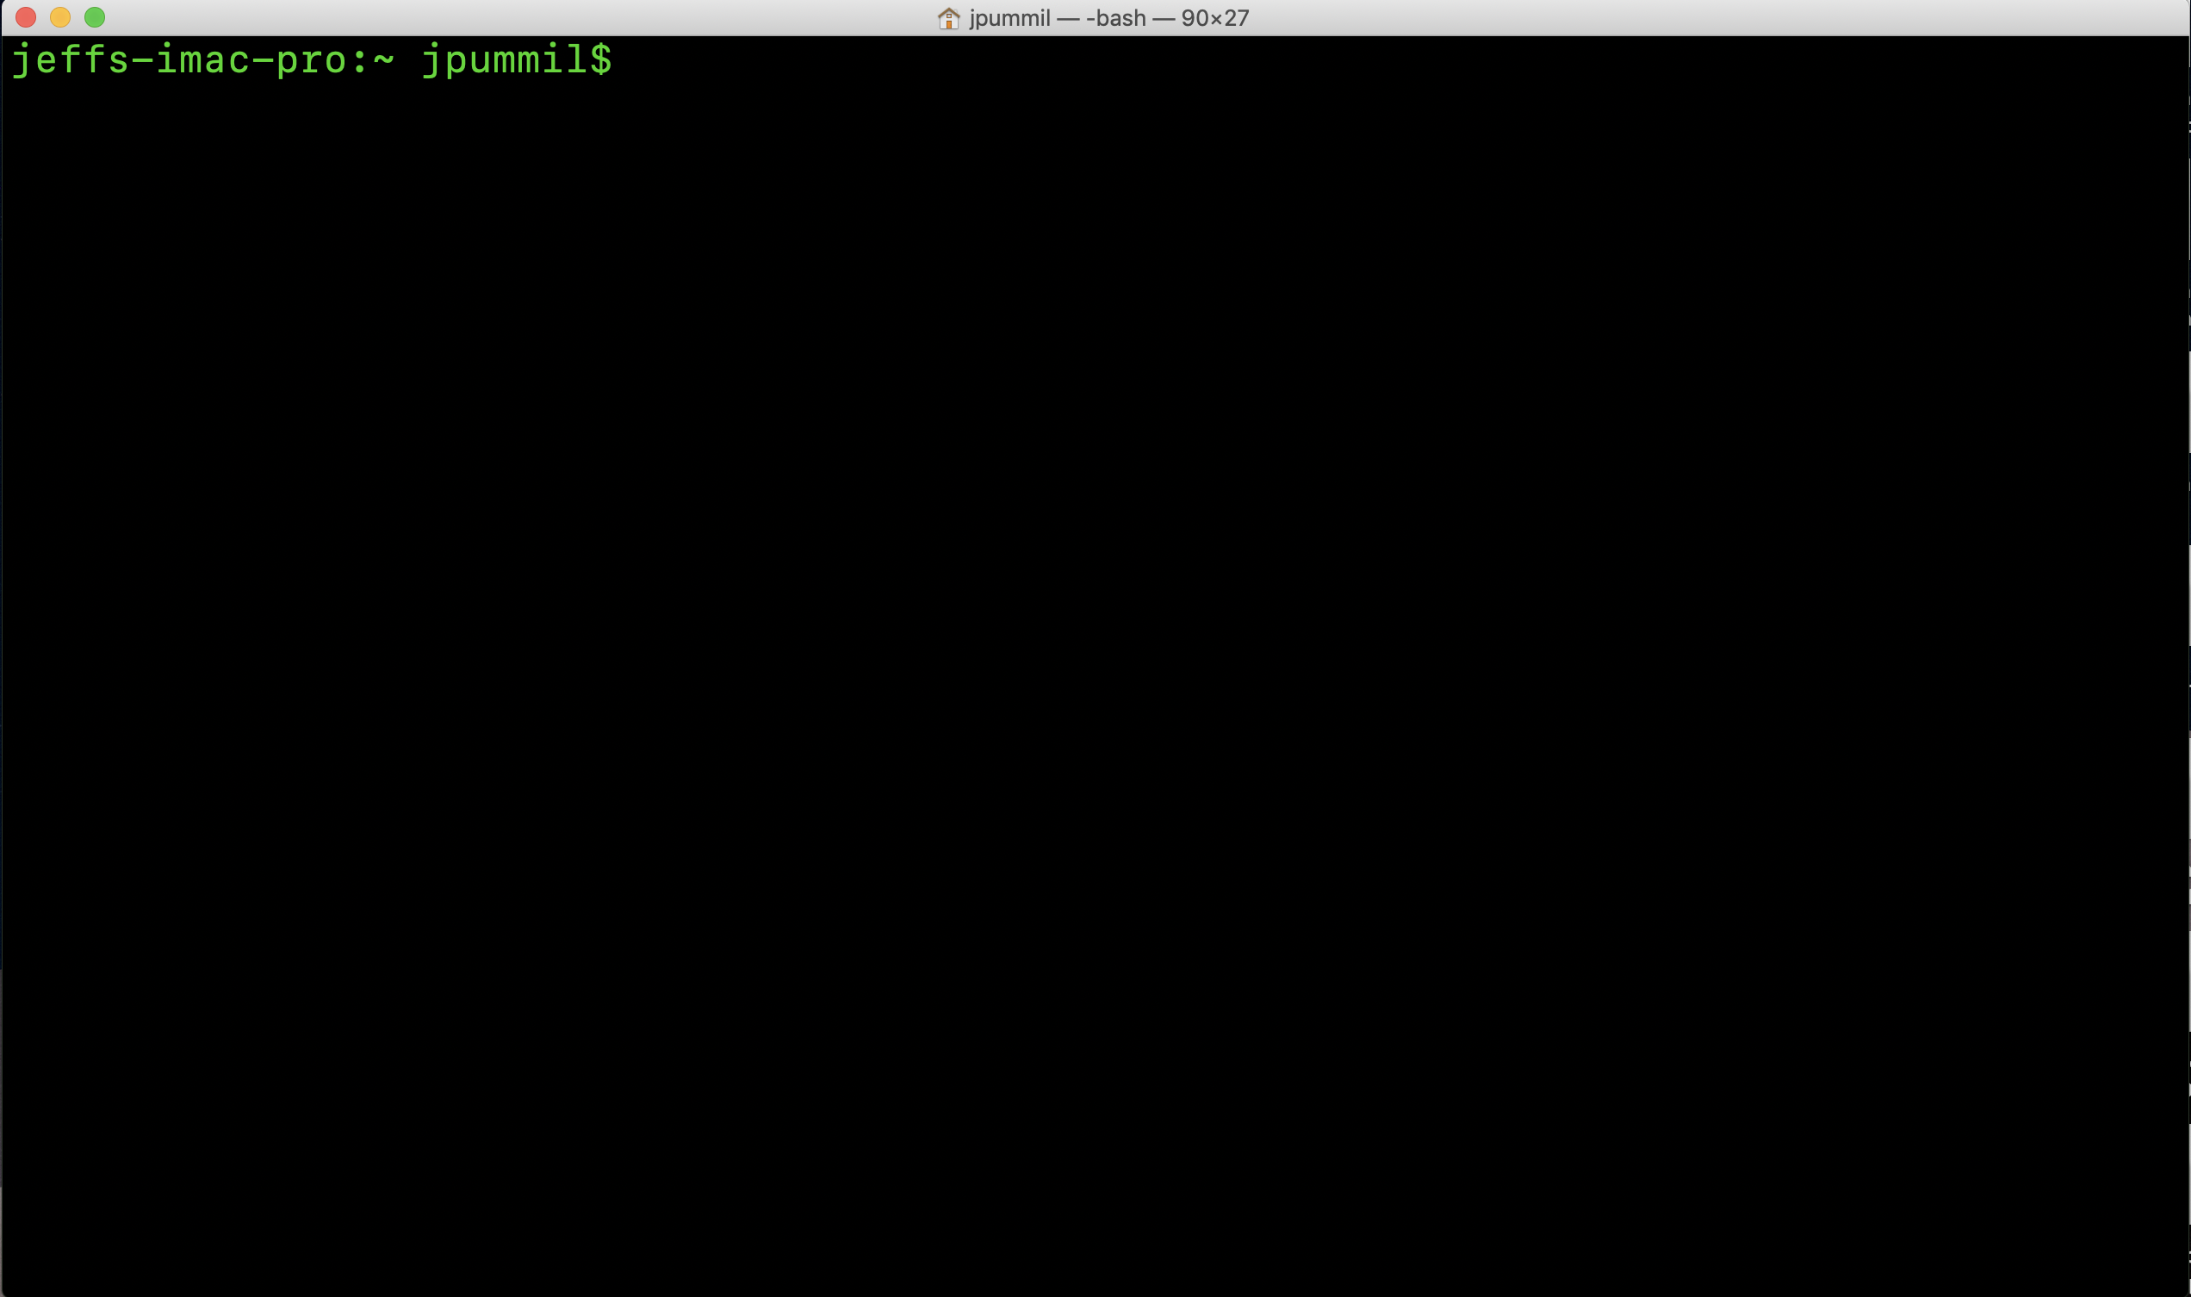
Scientific Computing for Biologists

Slide 5
Scientific Computing for Biologists
Terminal icon SHOULD be on the task bar already! If not…
To locate your terminal app, just go to the Finder on your iMac:
Select Applications
Then Utilities
Drag and drop the icon from Utilities onto the task bar

Slide 6
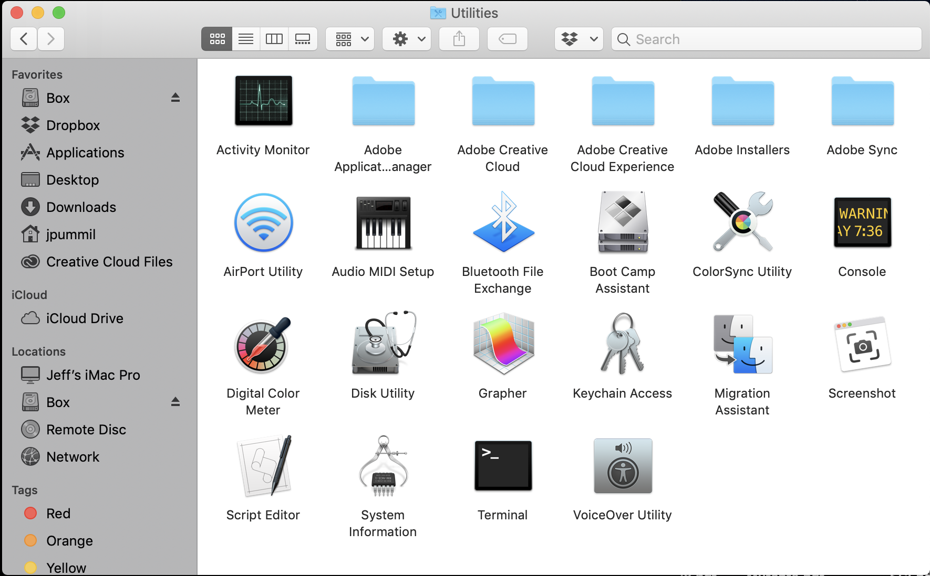
Scientific Computing for Biologists

Slide 7
Scientific Computing for Biologists
A few basic tips before we begin:
Linux/Unix is case sensitive – TEST, Test, and test are all DIFFERENT
Avoid spaces in filenames – test one (bad). test-one or test_one (good)
DO NOT use Windows to create text files you will use on Linux.
Windows adds hidden characters that won’t work on Linux.
DO assign suffixes to file names. Ex: test should be test.txt or test.dat
Linux doesn’t care…but humans need it to keep track.

Slide 8
Scientific Computing for Biologists
A recap of what we learned last time:
whoami - display effective user id
pwd – prints (displays) current working directory (folder)
ls – list contents of directory
command flags ( -l, -h, -a, and -F )
Use command –help to show all available flags
cd – change working (current) directory
short cuts ( ~, /, and . )
BONUS COMMAND: clear – clears the messy text in the terminal

Slide 9
Scientific Computing for Biologists
So, let’s get right to it! Some new basic commands to incorporate:
mkdir – create a new directory
touch – create an empty file
nano – Nano's ANOther text editor
cp – copy files and directories
mv – move or rename files and directories
rm – remove (delete) files and directories
BONUS COMMAND: clear – clears the messy text in the terminal
BONUS COMMAND: history – log of previous commands executed

Slide 10
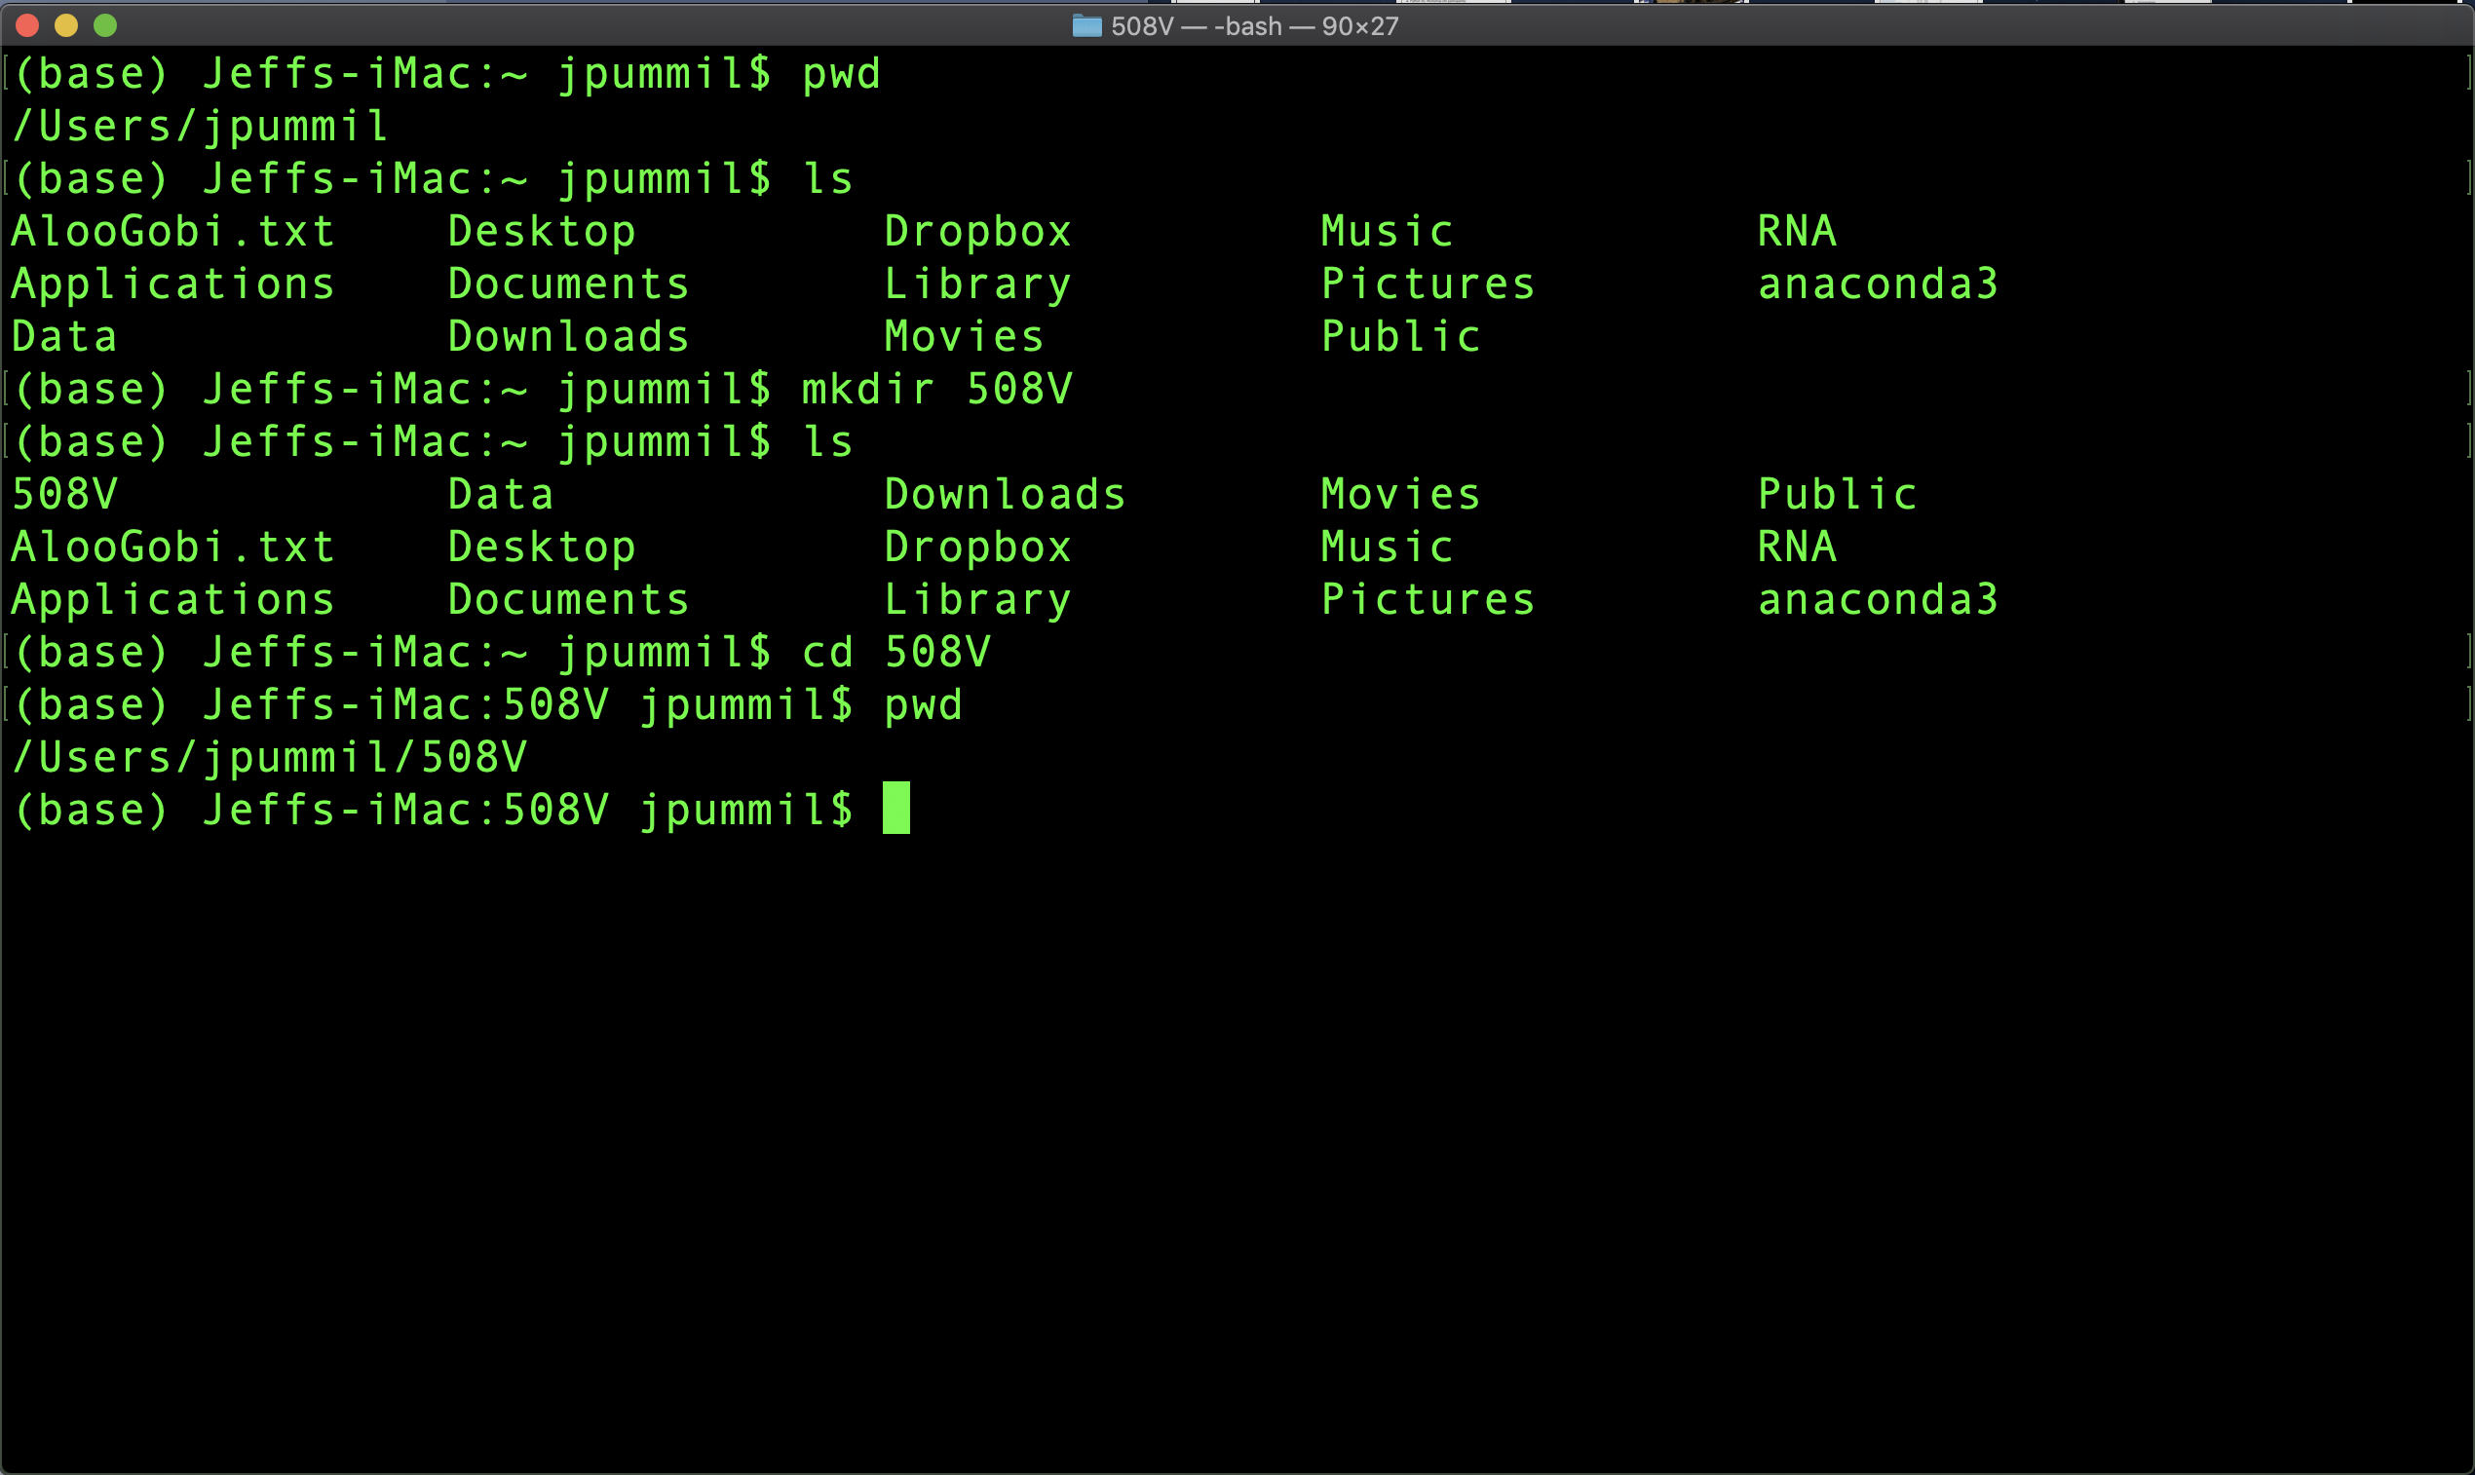
Scientific Computing for Biologists

Slide 11
Scientific Computing for Biologists
So, let’s get right to it! Some new basic commands to incorporate:
mkdir – create a new directory
touch – create an empty file
nano – Nano's ANOther text editor
cp – copy files and directories
mv – move or rename files and directories
rm – remove (delete) files and directories
BONUS COMMAND: clear – clears the messy text in the terminal
BONUS COMMAND: history – log of previous commands executed

Slide 12
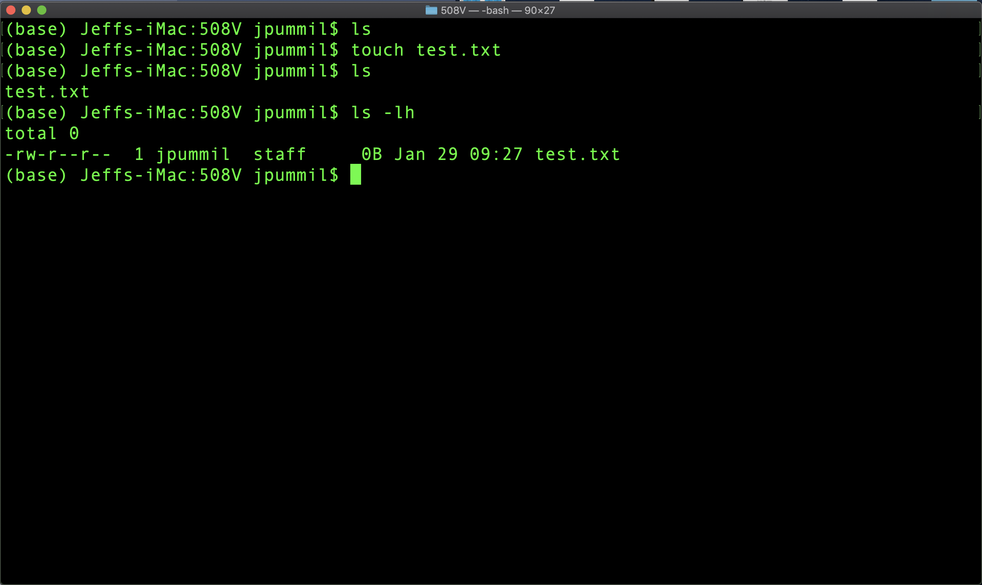
Scientific Computing for Biologists

Slide 13
Scientific Computing for Biologists
So, let’s get right to it! Some new basic commands to incorporate:
mkdir – create a new directory
touch – create an empty file
nano – Nano's ANOther text editor
cp – copy files and directories
mv – move or rename files and directories
rm – remove (delete) files and directories
BONUS COMMAND: clear – clears the messy text in the terminal
BONUS COMMAND: history – log of previous commands executed

Slide 14
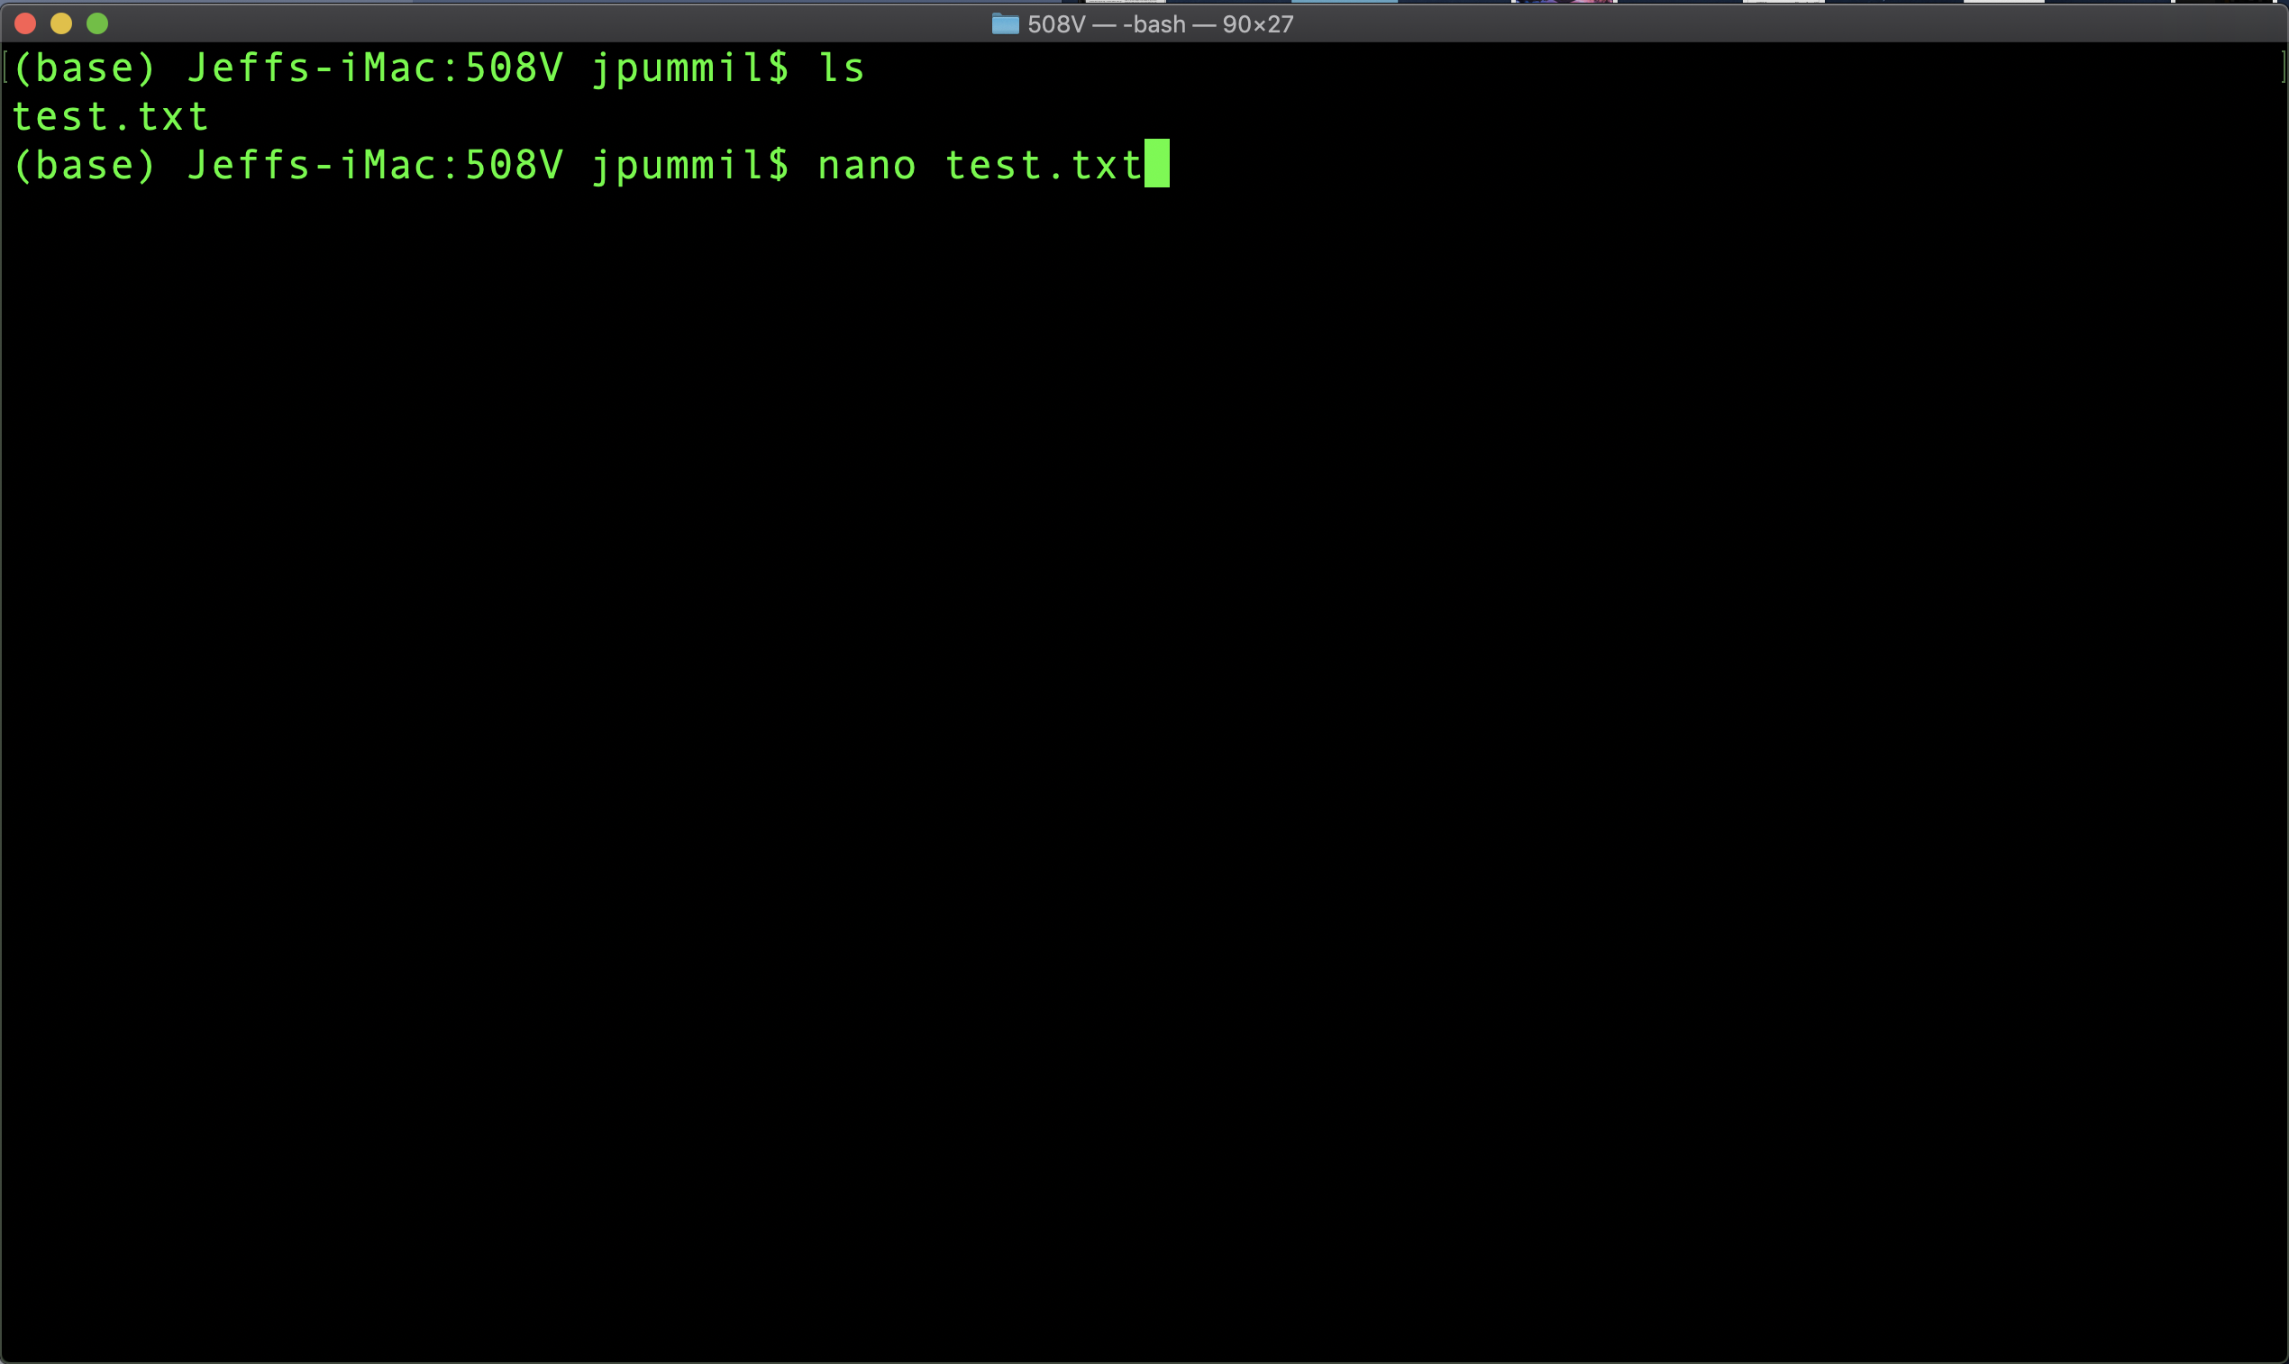
Scientific Computing for Biologists

Slide 15
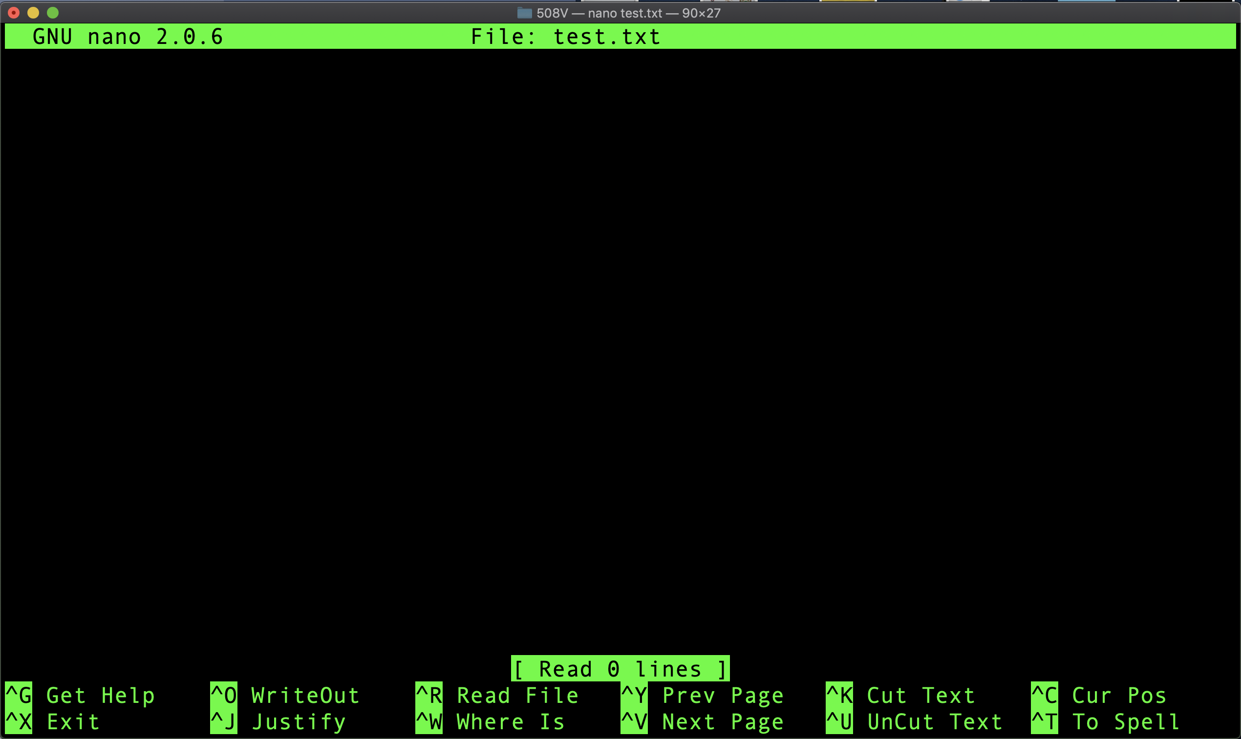
Scientific Computing for Biologists

Slide 16
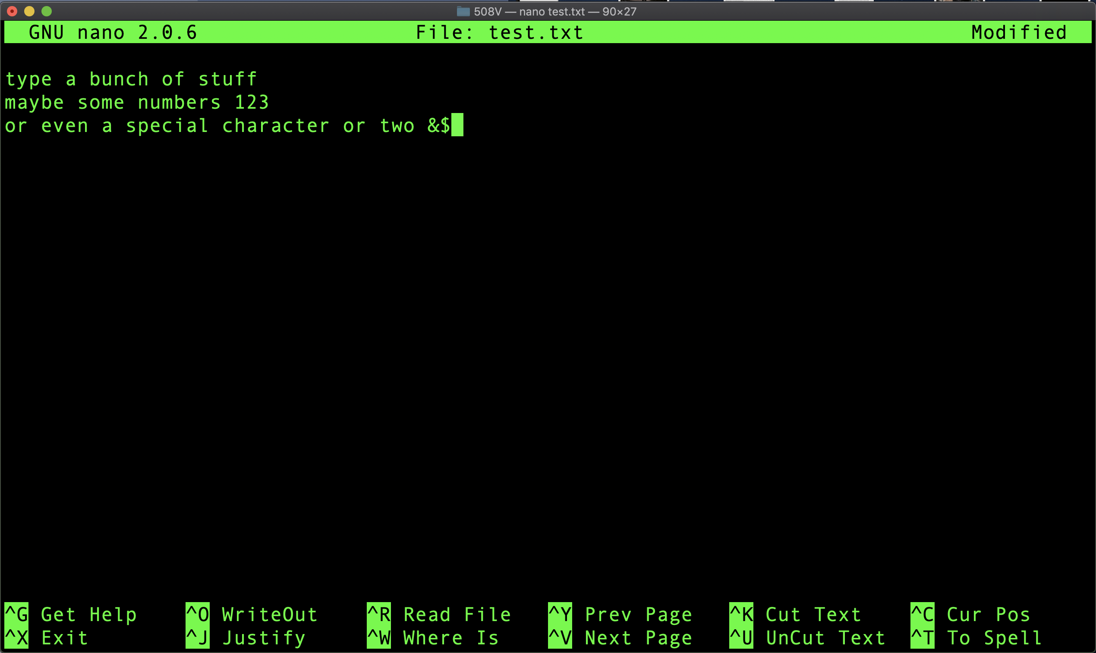
Scientific Computing for Biologists

Slide 17
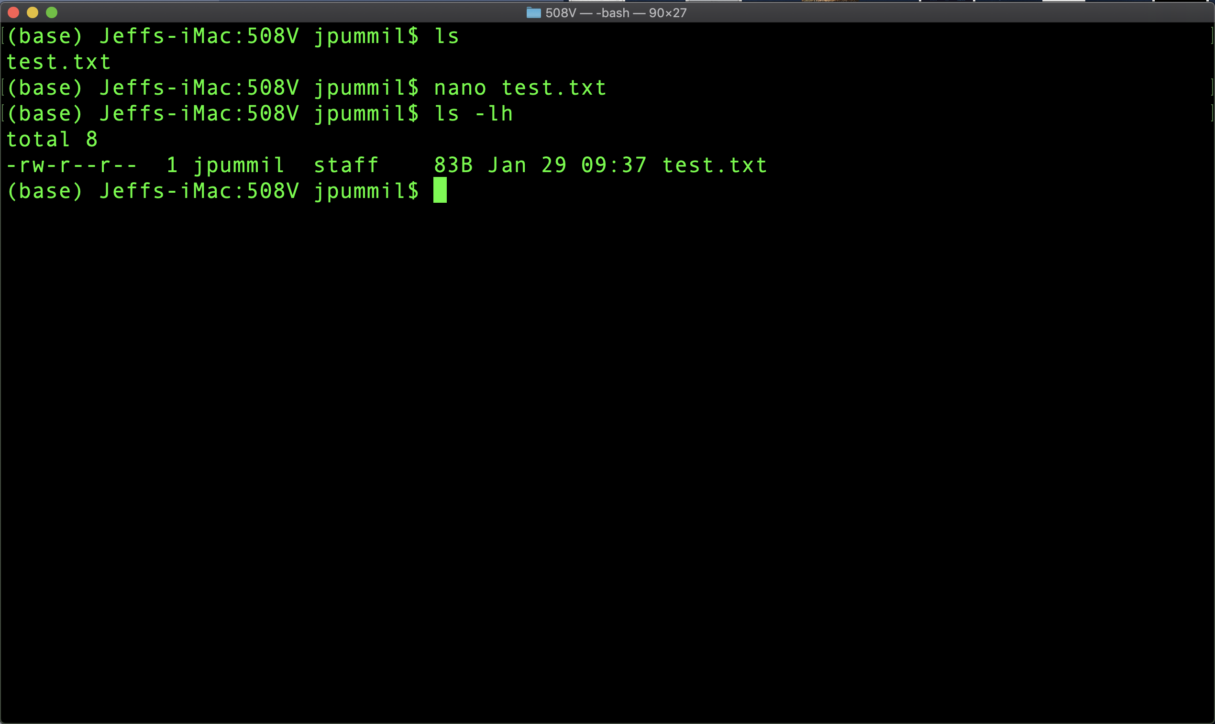
Scientific Computing for Biologists

Slide 18
Scientific Computing for Biologists
Half time!
5-10 minute break…

Slide 19
Scientific Computing for Biologists
So, let’s get right to it! Some new basic commands to incorporate:
mkdir – create a new directory
touch – create an empty file
nano – Nano's ANOther text editor
cp – copy files and directories
mv – move or rename files and directories
rm – remove (delete) files and directories
BONUS COMMAND: clear – clears the messy text in the terminal
BONUS COMMAND: history – log of previous commands executed

Slide 20
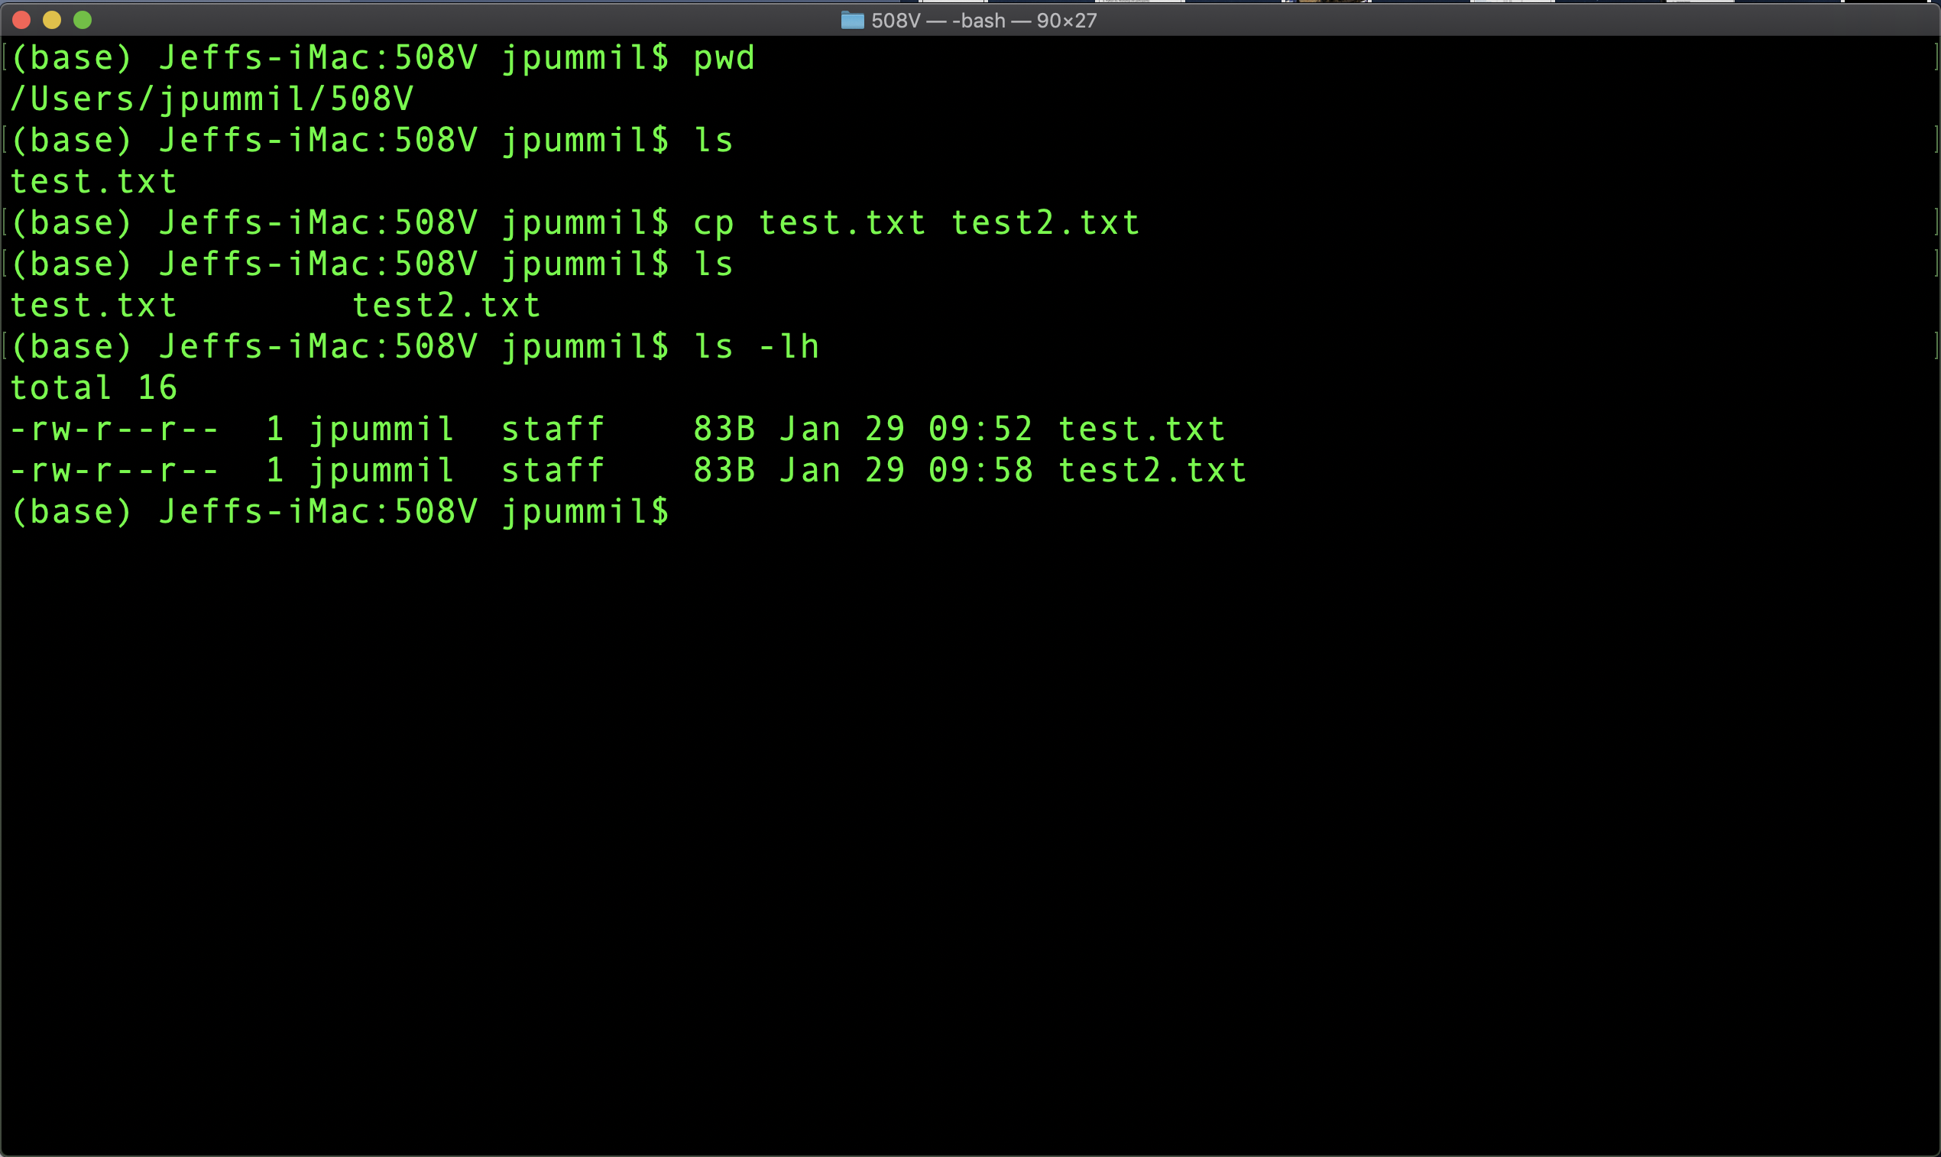
Scientific Computing for Biologists

Slide 21
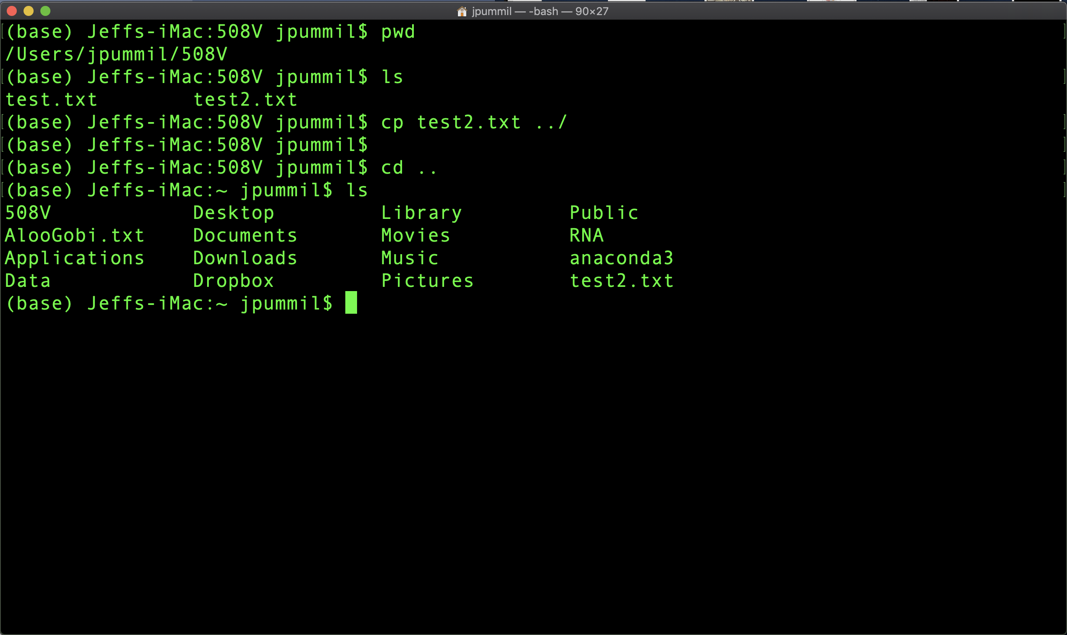
Scientific Computing for Biologists

Slide 22
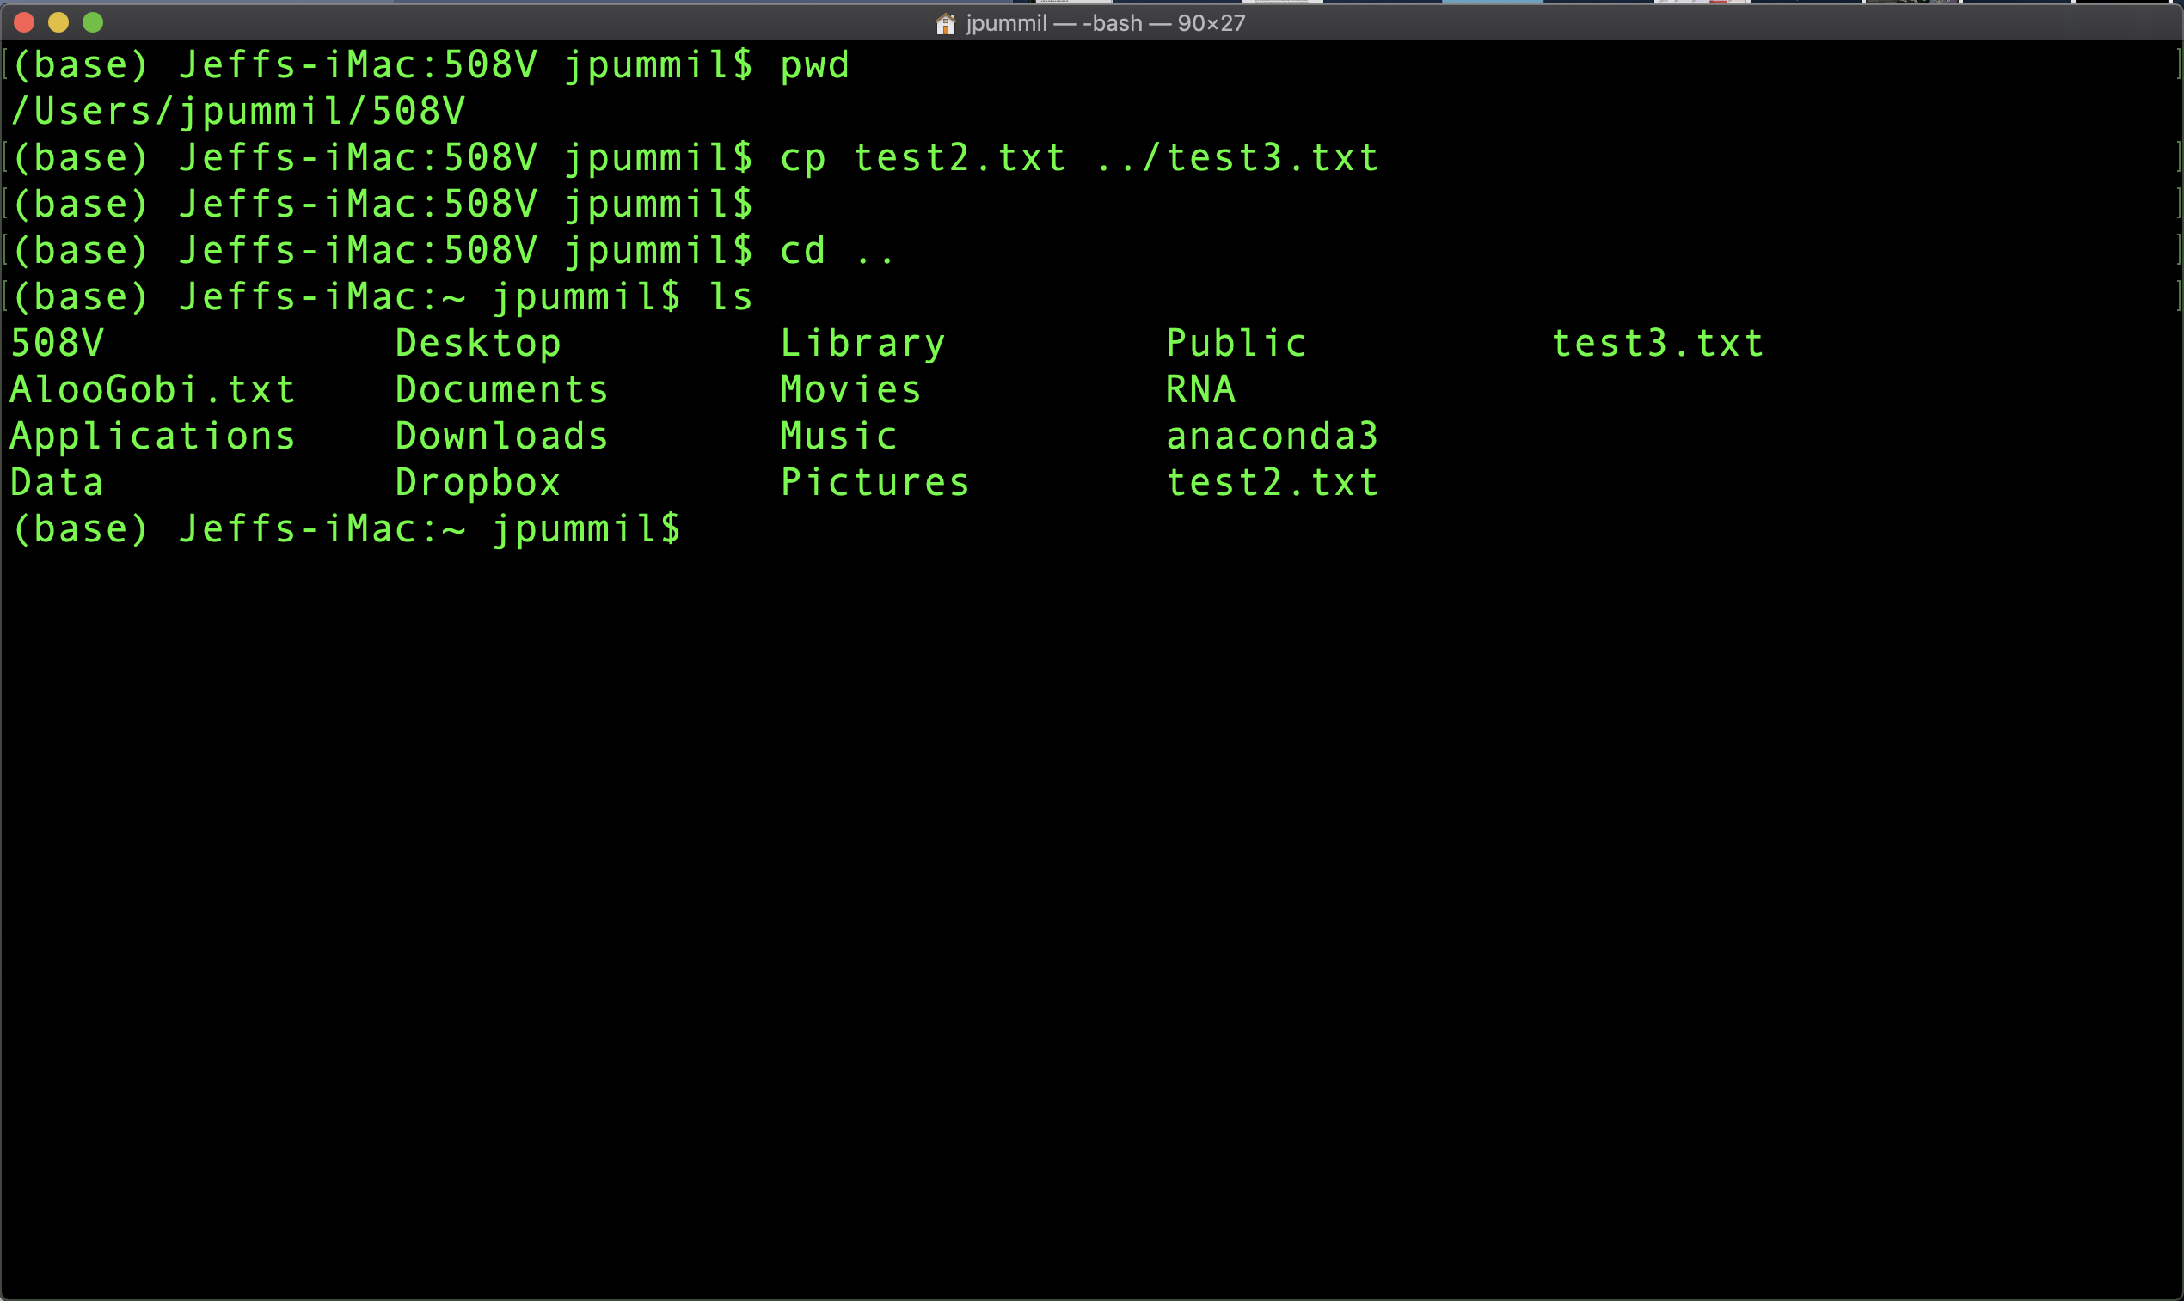
Scientific Computing for Biologists

Slide 23
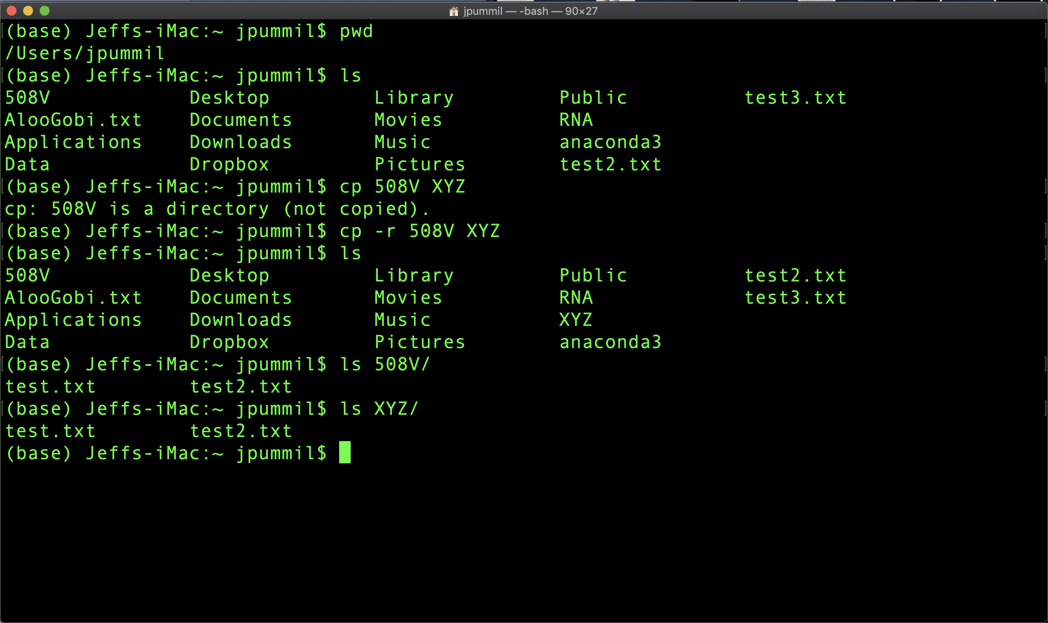
Scientific Computing for Biologists

Slide 24
Scientific Computing for Biologists
So, let’s get right to it! Some new basic commands to incorporate:
mkdir – create a new directory
touch – create an empty file
nano – Nano's ANOther text editor
cp – copy files and directories
mv – move or rename files and directories
rm – remove (delete) files and directories
BONUS COMMAND: clear – clears the messy text in the terminal
BONUS COMMAND: history – log of previous commands executed

Slide 25
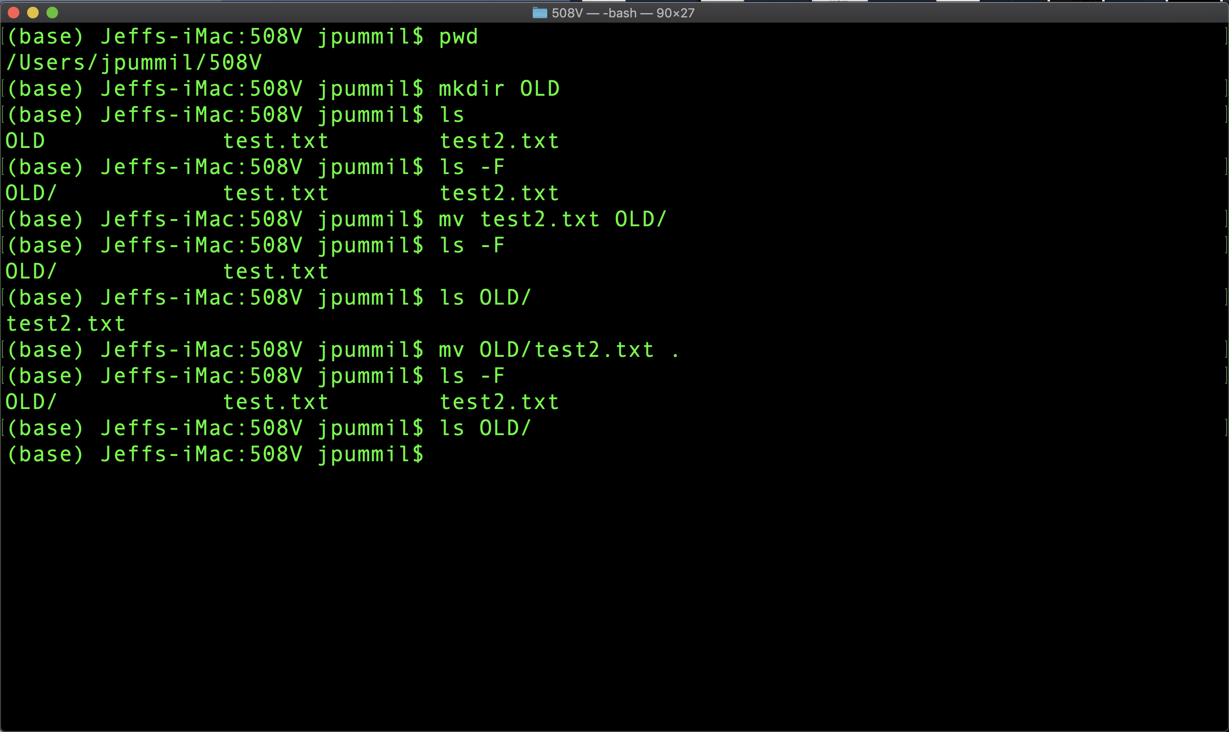
Scientific Computing for Biologists

Slide 26
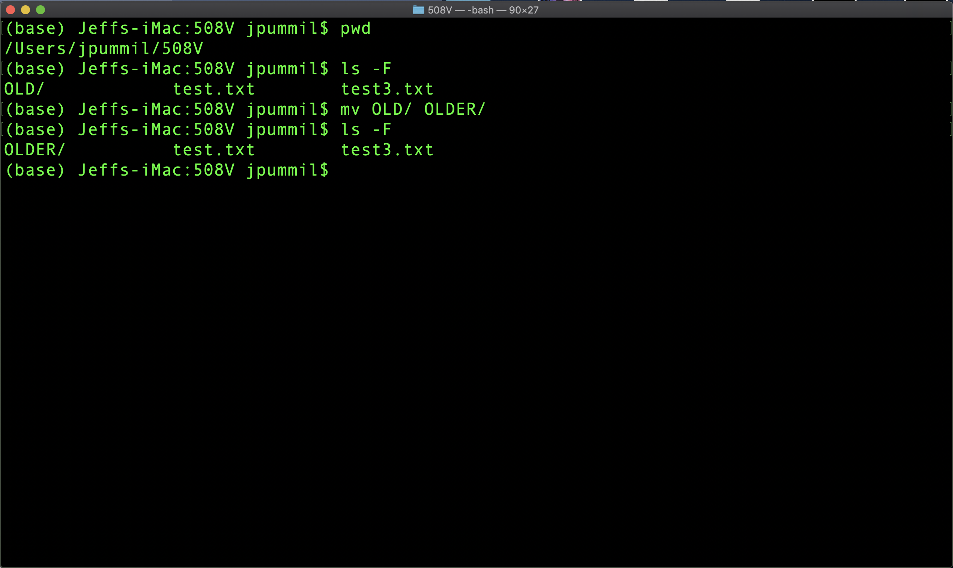
Scientific Computing for Biologists

Slide 27
Scientific Computing for Biologists
So, let’s get right to it! Some new basic commands to incorporate:
mkdir – create a new directory
touch – create an empty file
nano – Nano's ANOther text editor
cp – copy files and directories
mv – move or rename files and directories
rm – remove (delete) files and directories
BONUS COMMAND: clear – clears the messy text in the terminal
BONUS COMMAND: history – log of previous commands executed

Slide 28
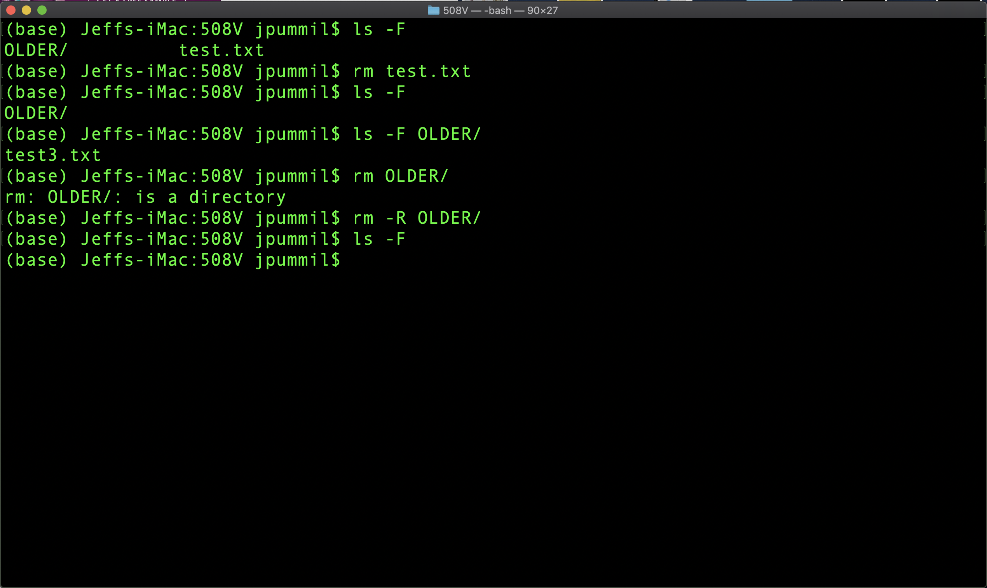
Scientific Computing for Biologists

Slide 29
Scientific Computing for Biologists
IMPORTANT NOTE:
When using “rm” command, there is NO trash can, etc! Once it’s gone, you CAN NOT retrieve it if you change your mind!

Slide 30
Scientific Computing for Biologists
So, let’s get right to it! Some new basic commands to incorporate:
mkdir – create a new directory
touch – create an empty file
nano – Nano's ANOther text editor
cp – copy files and directories
mv – move or rename files and directories
rm – remove (delete) files and directories
BONUS COMMAND: clear – clears the messy text in the terminal
BONUS COMMAND: history – log of previous commands executed

Slide 31
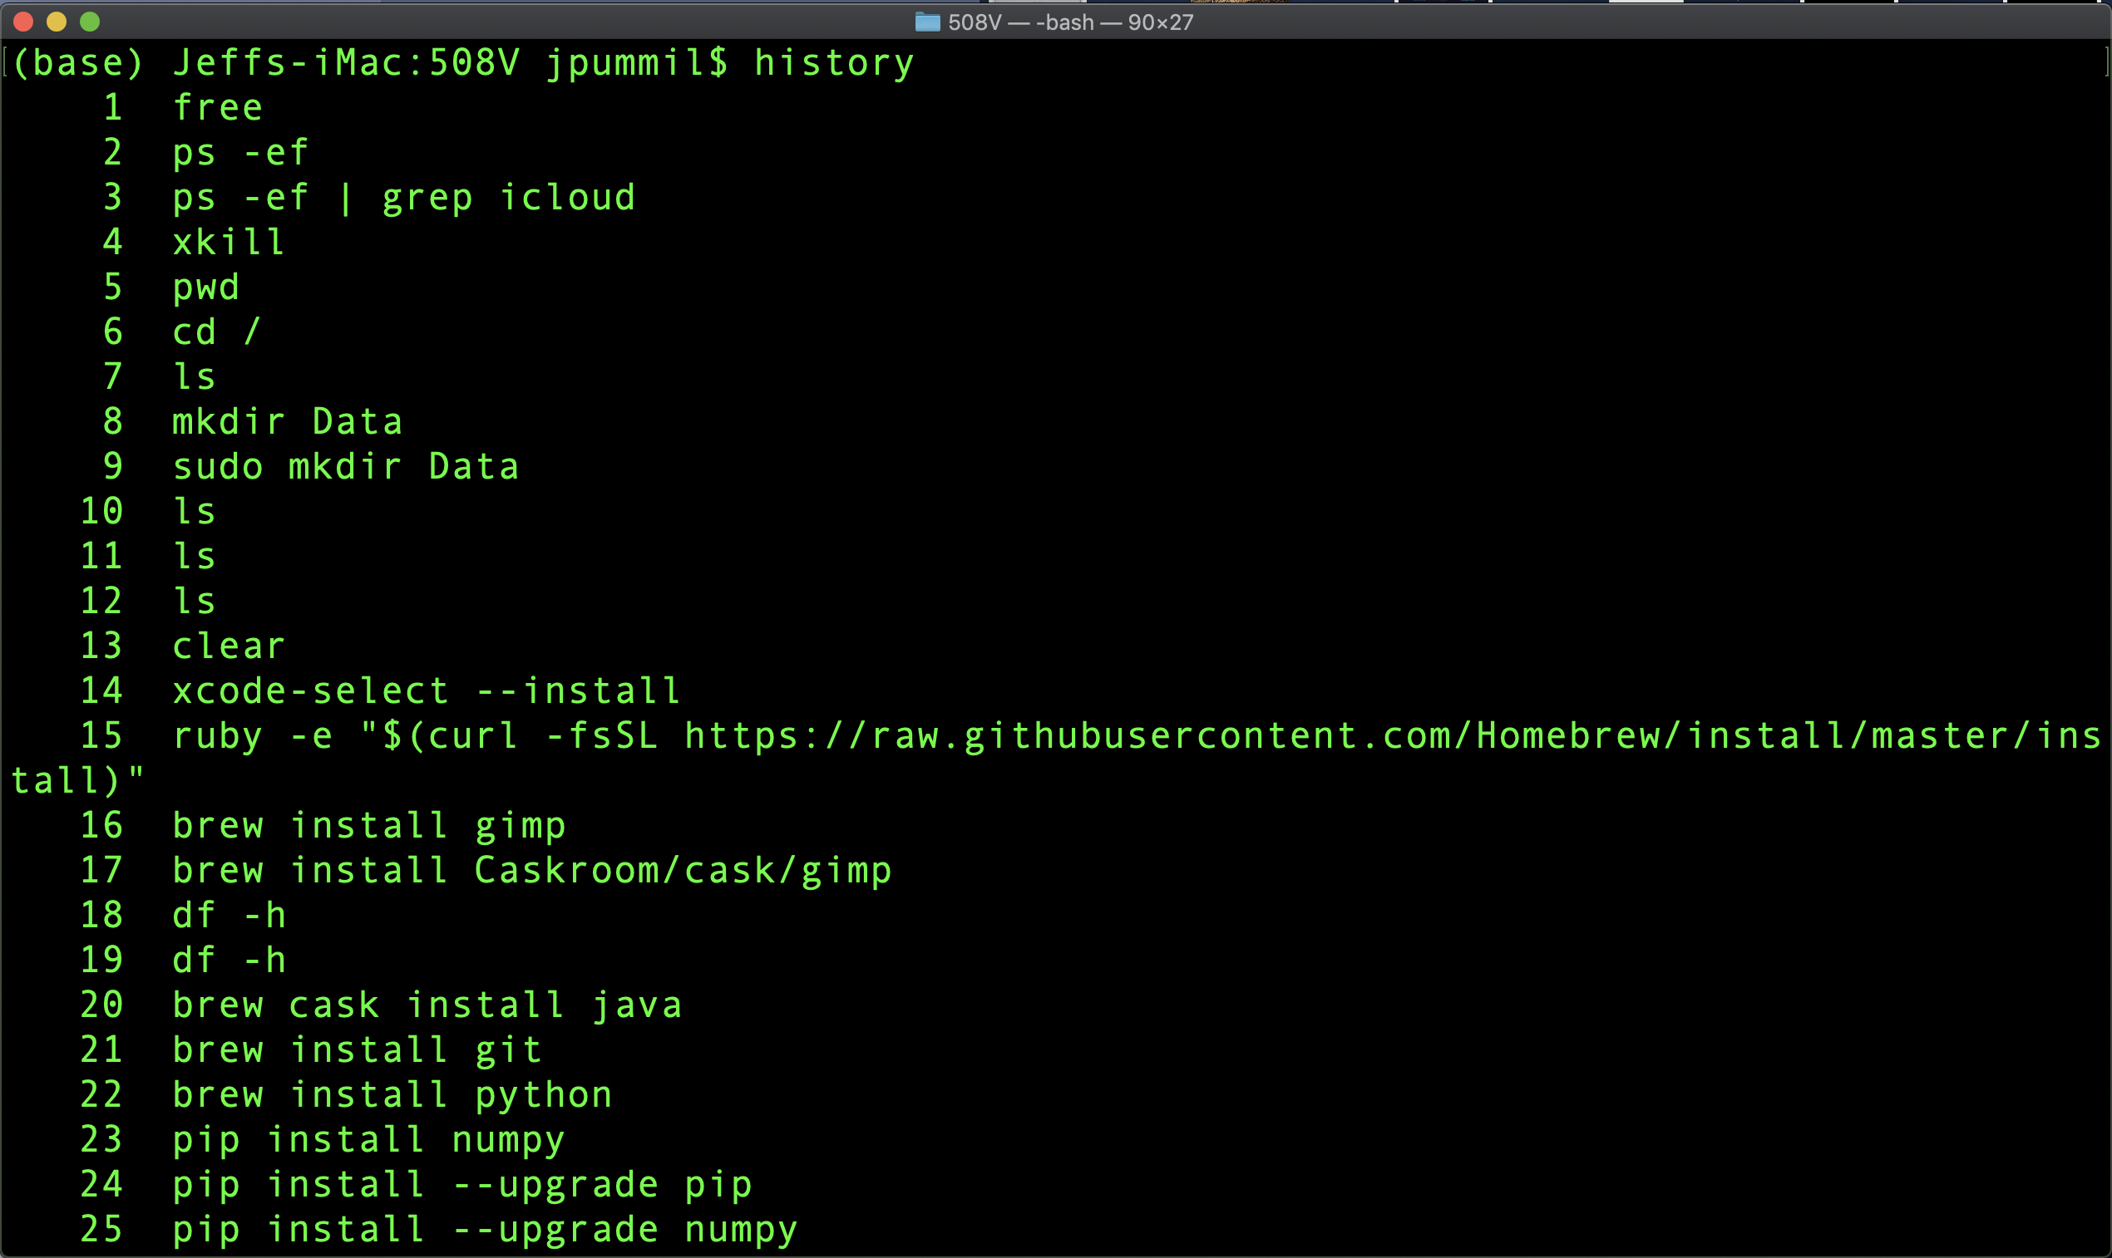
Scientific Computing for Biologists

Slide 32
Scientific Computing for Biologists
HISTORY USAGE:
In addition to keeping a record of previous comands you’ve executed on the command line, you can re-issue a past command by typing ! and the command number
!13 would run my “clear” command according to the previous slide

Slide 33
Scientific Computing for Biologists
For the rest of this class session, experiment with:
Get some practice with creating files with nano and adding content to them.
Using cp, mv, and rm with their various flags ( the –h or –help options work with these commands as well ) to manipulate both files and directories in conjunction with the earlier cd, ~, .., /, commands.
Forget how to use a command you’ve already used? Go back and look with “history”

Slide 34
Scientific Computing for Biologists
Jeff Pummill
Director – Strategic Initiatives & User Services
Arkansas High Performance Computing Center
Adjunct Graduate Faculty – Biological Sciences
University of Arkansas – JBHT 410
jpummil@uark.edu
@jpummil on Twitter

